Slide 1

IAS PPT Anant Agarwal RA2011030010129

Slide 2
Why Cyber Security?
Cyber Security means protecting data, networks, programs and other information from unauthorized or unattended access, destruction or change.
In today’s digital era, Cyber Security is the important thing because of the vast rise of Cyber attacks and increased digitalization
Cybercriminals are becoming more sophisticated, changing what they target, how they affect organizations, and their methods of attack on different security systems.
Globally, 30,000 websites are hacked daily.
64% of companies worldwide have experienced at least one form of a cyber attack.
In 2021, Ransomware cases grew by 92.7% .

Slide 3
MOST TRENDING TYPES OF ATTACKS
Social Engineering
Phishing
DoS and DDoS
Voice Phishing Or Vishing
Malware
Ransomware.
Man-in-the-Middle Attack.

Slide 4

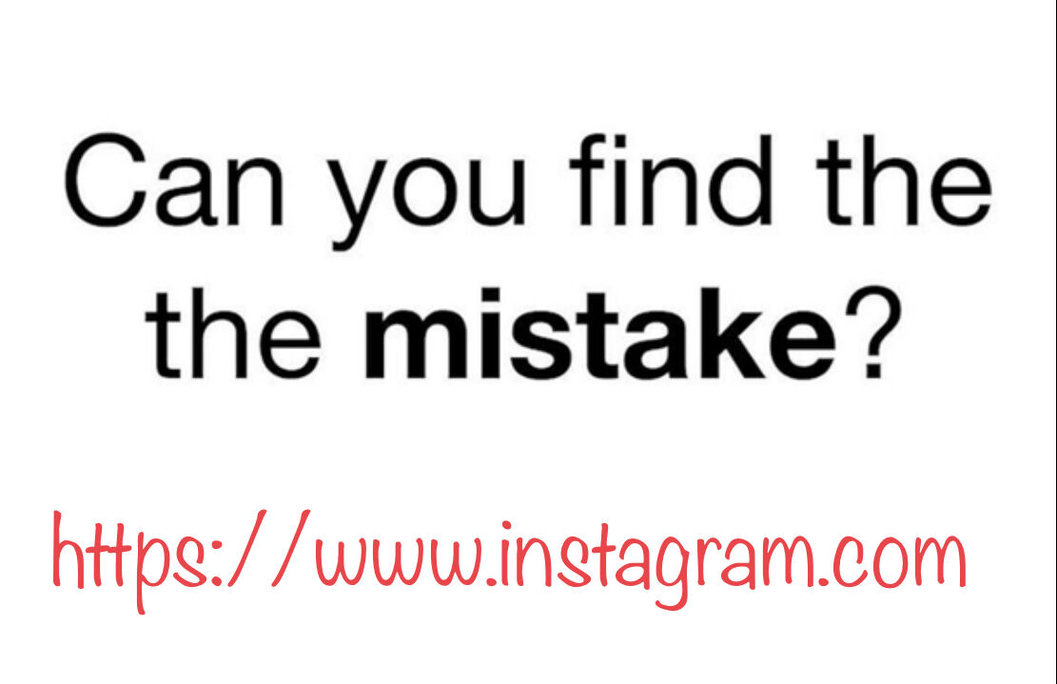
Notes:
https://www.linkedin.com/posts/gabrielfriedlander_lets-play-if-you-figured-it-out-comment-activity-6853476793853239296-j2aI

Slide 5

Social Engineering
Is about
Distraction
and
Misdirection

Slide 6

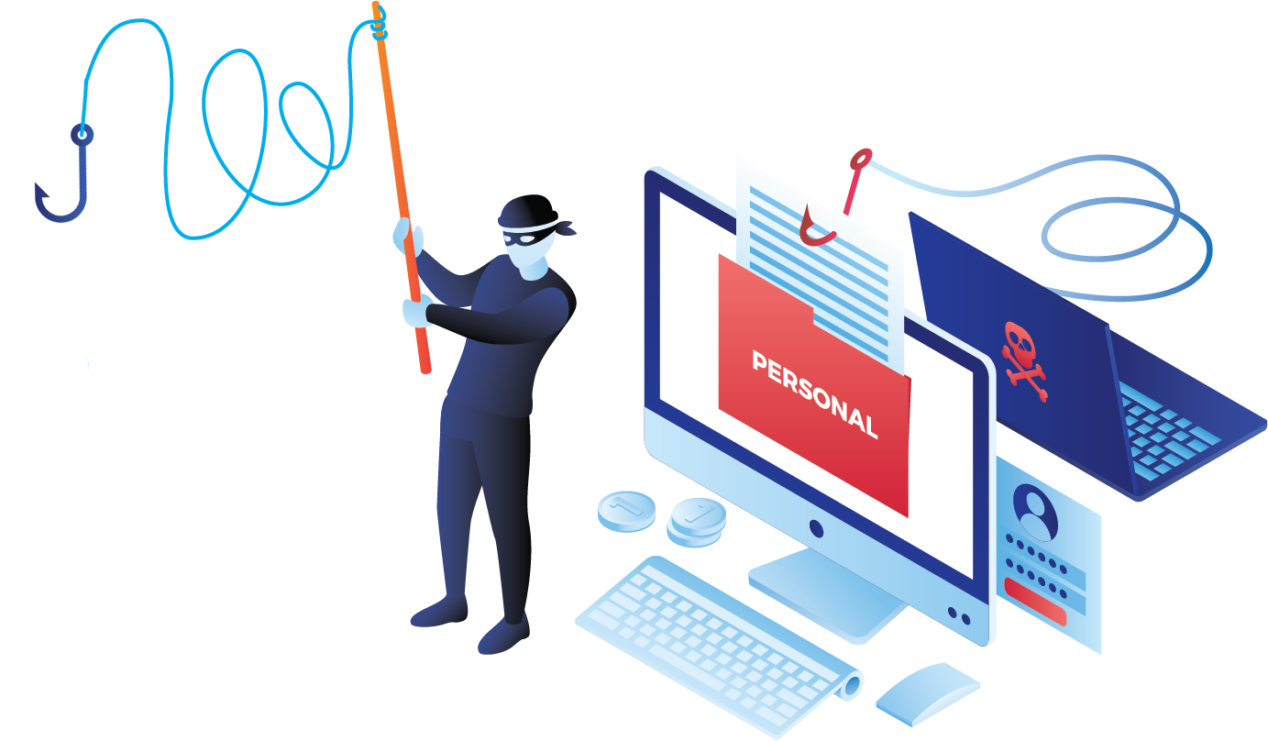
Phishing
When Scammers fool you to think they are someone you trust in order to make you do something.

Slide 7

7 Types of Phishing Scams You Should Know About

Slide 8
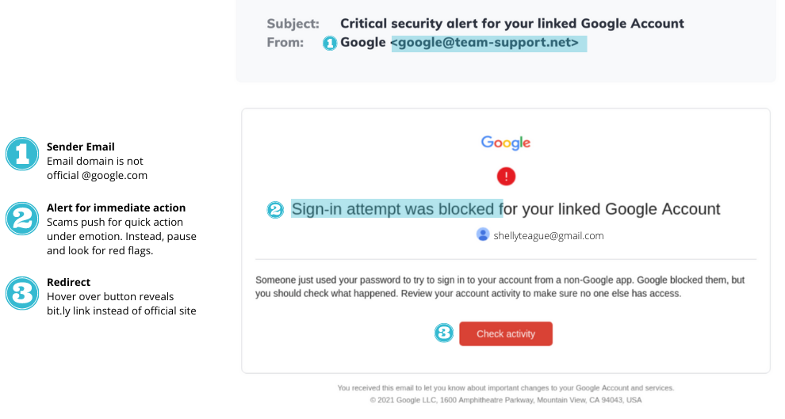
Email Phishing Scams
It may look like an email from your bank, Paypal, Google, Amazon, or even your CEO.

Slide 9
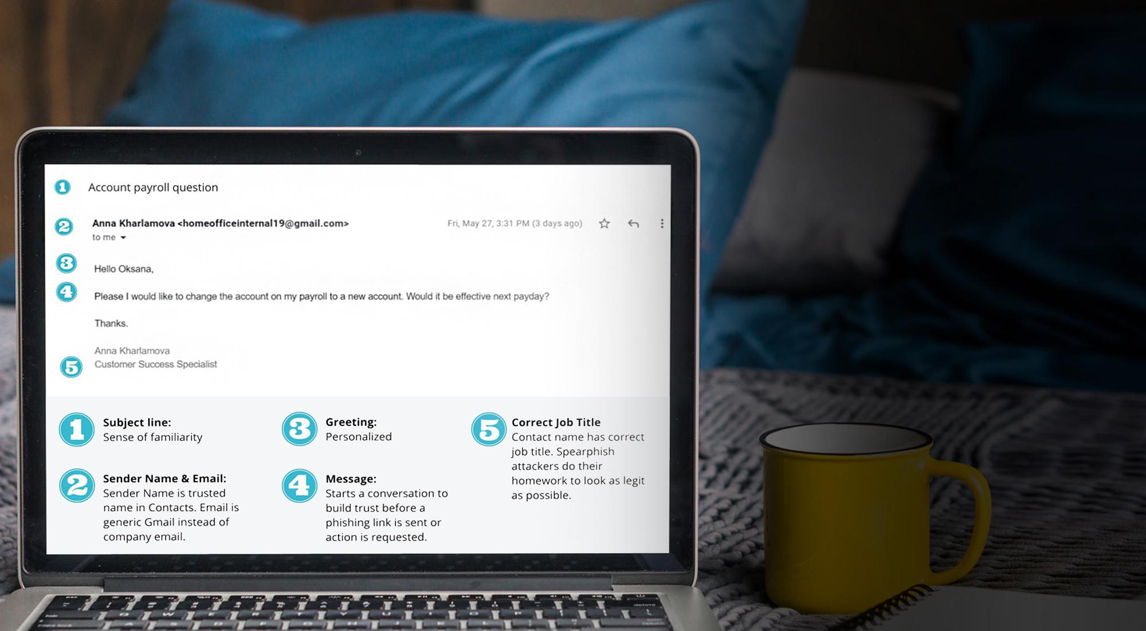
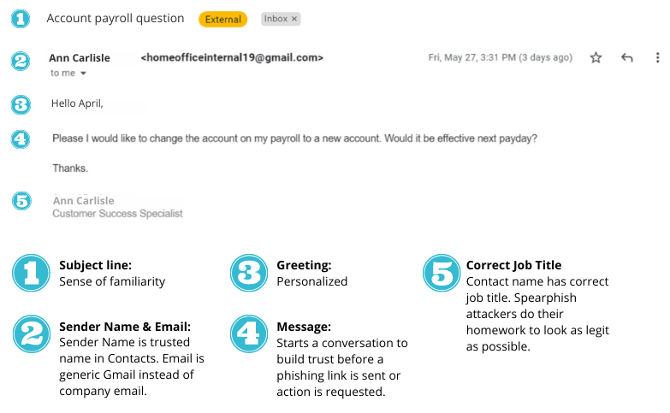
Spear Phishing Scams
This is when they target you specifically. They have researched you, they know your family members, where you work, and who is your boss. The chances of fooling you are higher.

Slide 10
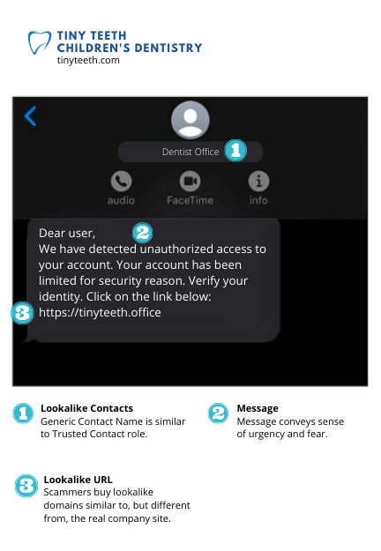
Smishing
Scams
These are text message phishing scams. Criminals know people respond to text and instant messages faster than email.

Slide 11
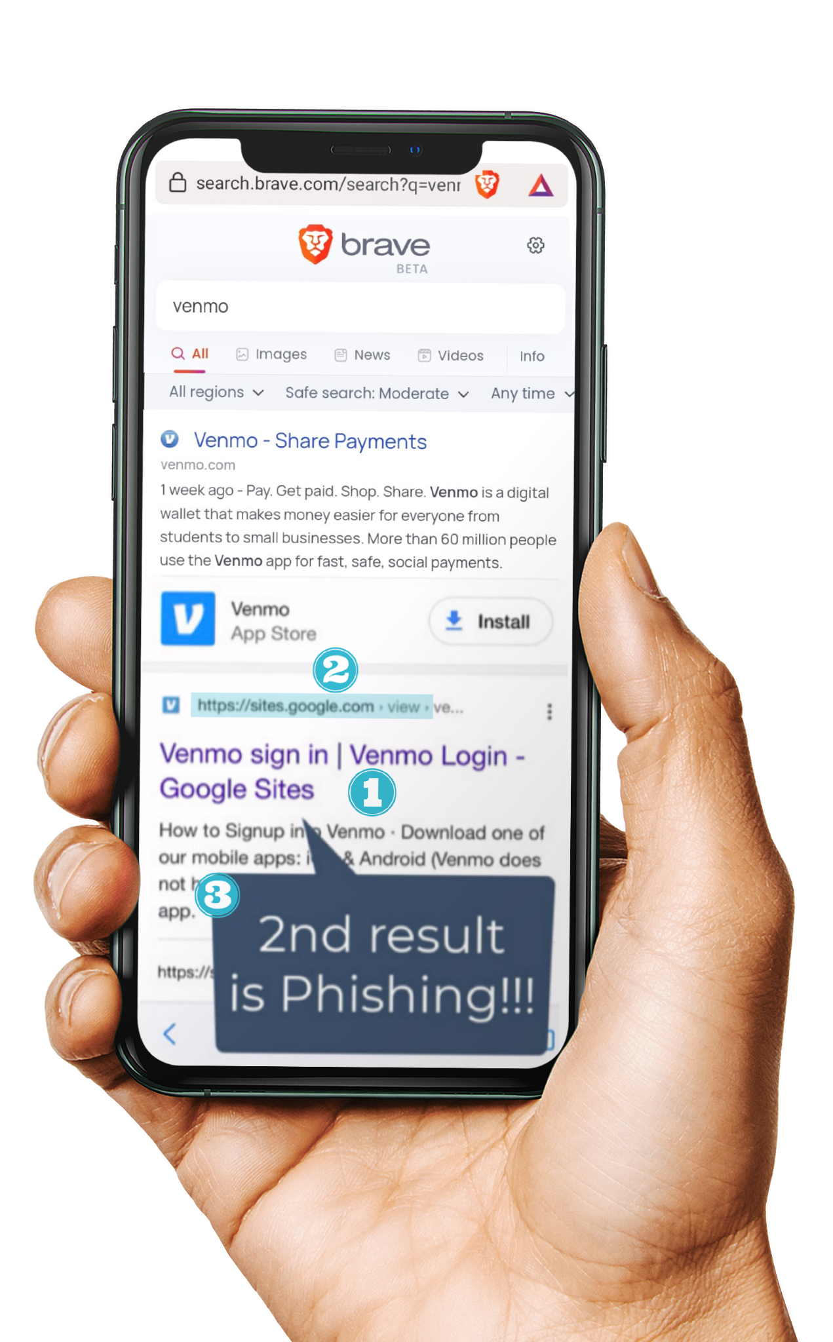



Google
Search
Scams
Search Result Shows Brand
Title displays correct brand name
You may be surprised, but some of the top search results in Google are phishing links.
Scammers also invest in search engine optimization and work hard to rank their scam sites in the top search results.
URL Mismatch
Title says Venmo but URL is a generic sites.google.com
2nd Result for Organic Search
Even top search results can be manipulated for fake sites

Slide 12
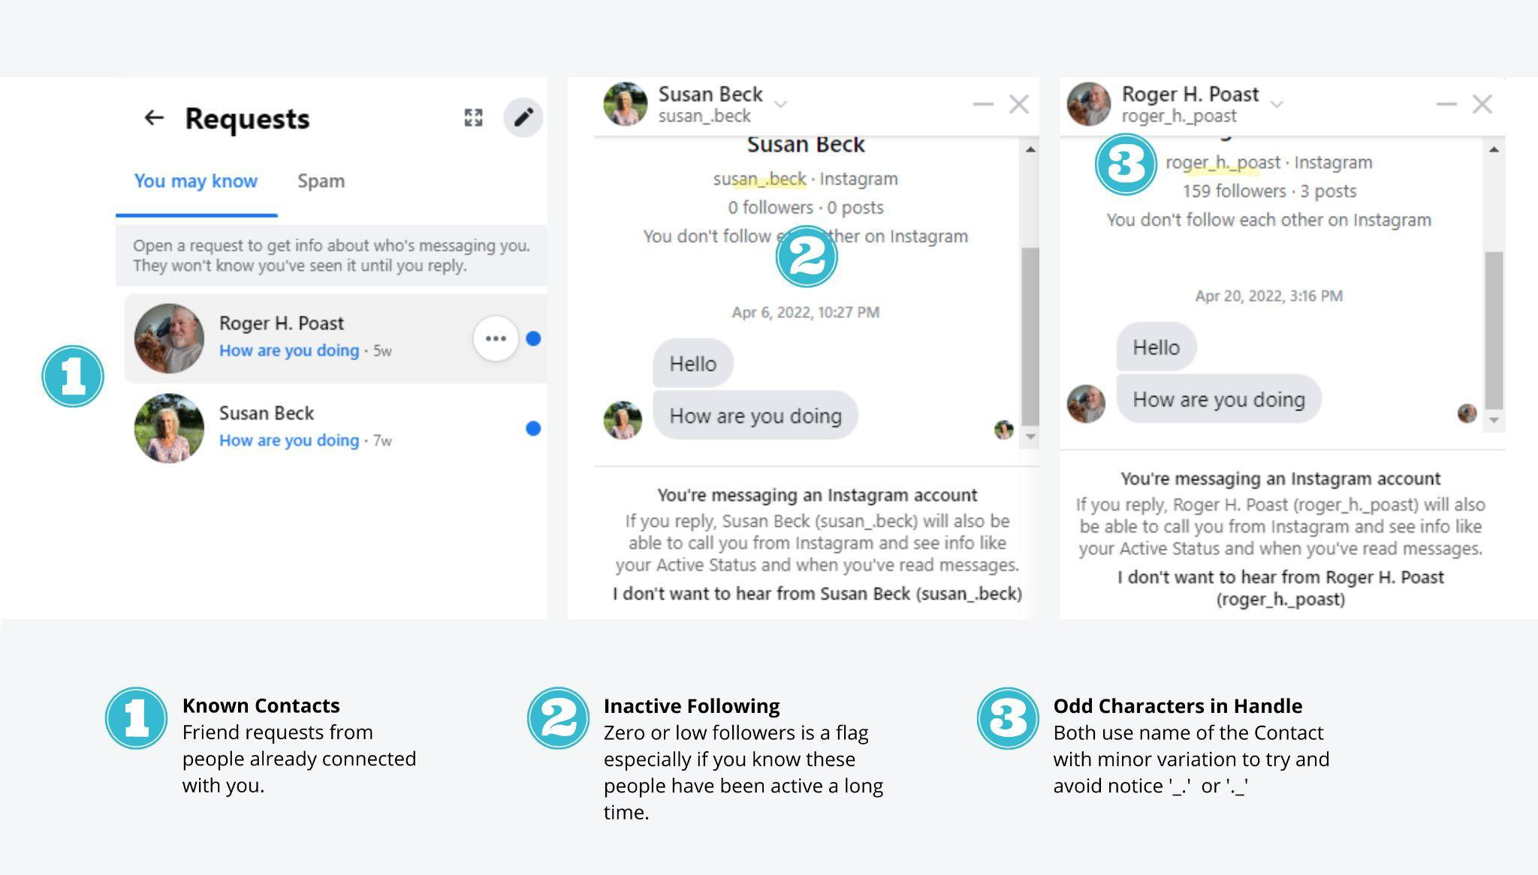
Social Media Scams
Social media is full
of fake accounts.
It could also be a fake account with the same name and photo as one of your real friends that will later try to scam you.

Slide 13
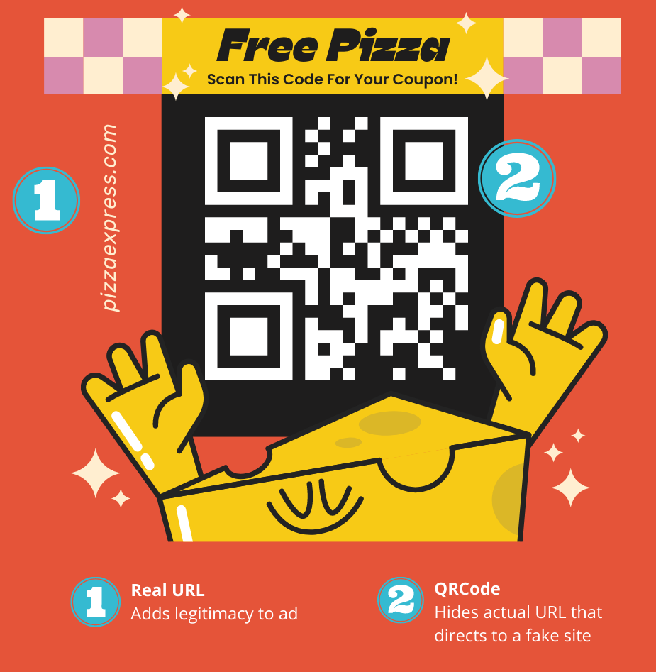
QR Code Scams
Who thought a QR code could be dangerous?
They are everywhere, especially in restaurants. Criminals can place their own sticker over the legitimate one. So that when you scan it, you will be redirected to a fake site.

Slide 14
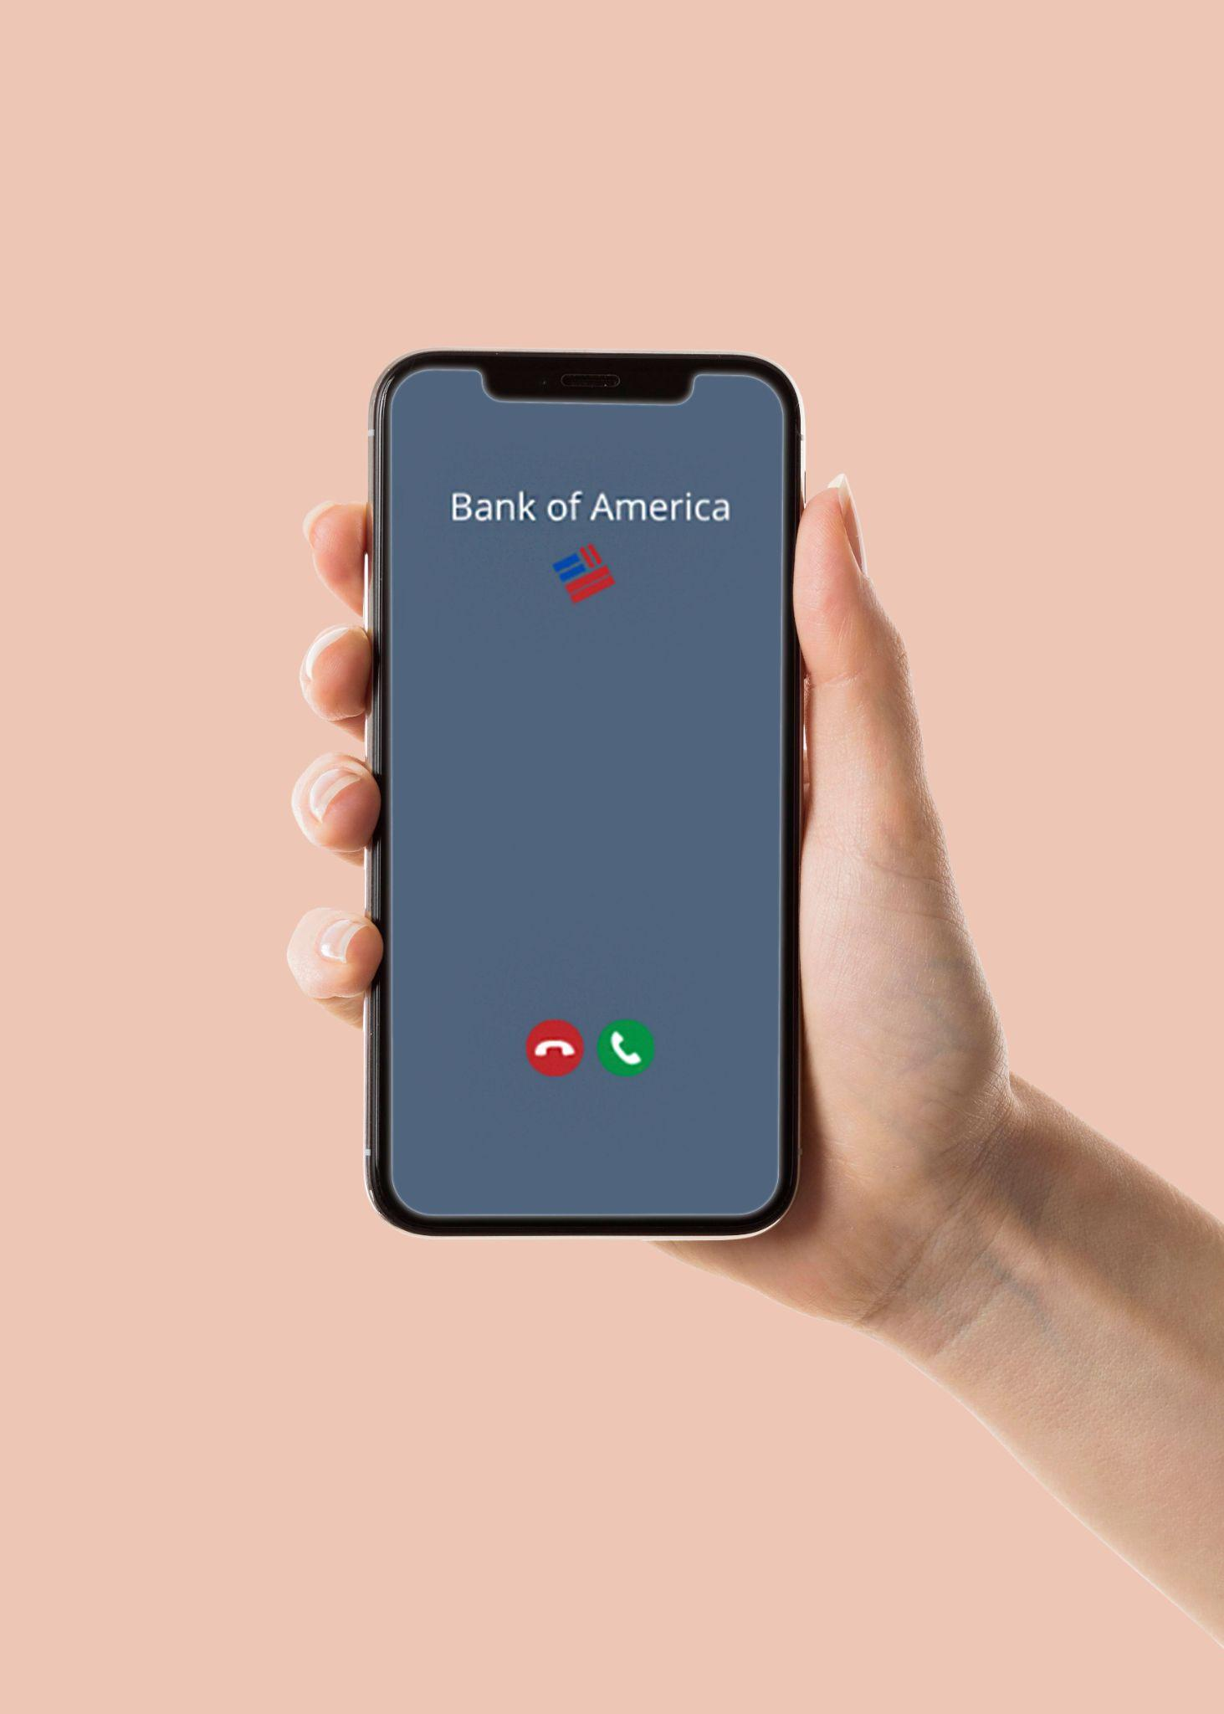


Vishing Scams
Vishing (voice phishing) is a type of phishing attack made over the telephone. Scammers can spoof a phone number that looks identical to a known number, like your bank.
Trusted Brands
Numbers for personal and commercial contacts can be spoofed.

Slide 15
What Helps Protect You From Phishing Attacks?
Call and verify! - Verify that you are talking to the correct person
Check the address - Always check the email address and URL for spelling mistakes
Enable Multi-Factor Authentication
Look at the style of the message
Ask questions

Slide 16
How long will it take
to crack your password
7 characters | 1 minute
8 characters | 1 hour
9 characters | 3-4 days
10 characters | 7 months
11 characters | 40 year
12 characters | 2000 years
Passwords include - Lowercase, Uppercase and Numbers

Slide 17
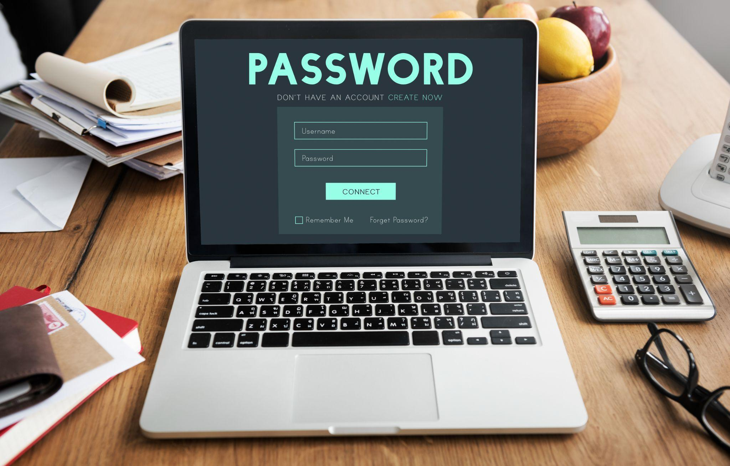
How to create a strong Password:
Passwords need to be long!
Use a phrase (NO personal info like your name or B-Day)
Don’t reuse passwords!

Slide 18
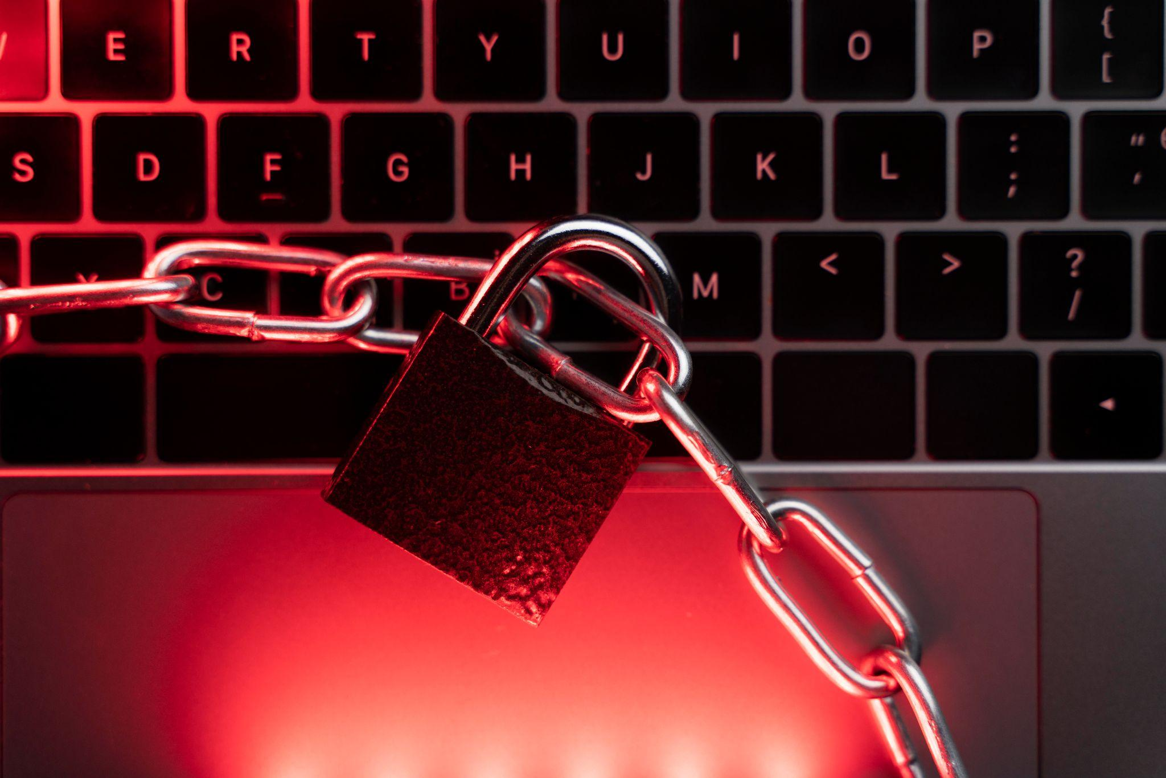
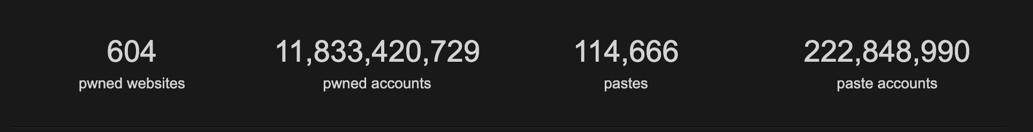
HOWEVER….
11 BILLION Accounts were stolen from
hacked sites and apps.
So even if you have a STRONG PASSWORD, it may still not be enough.
You can check if yours was leaked at haveibeenpwned.com

Slide 19
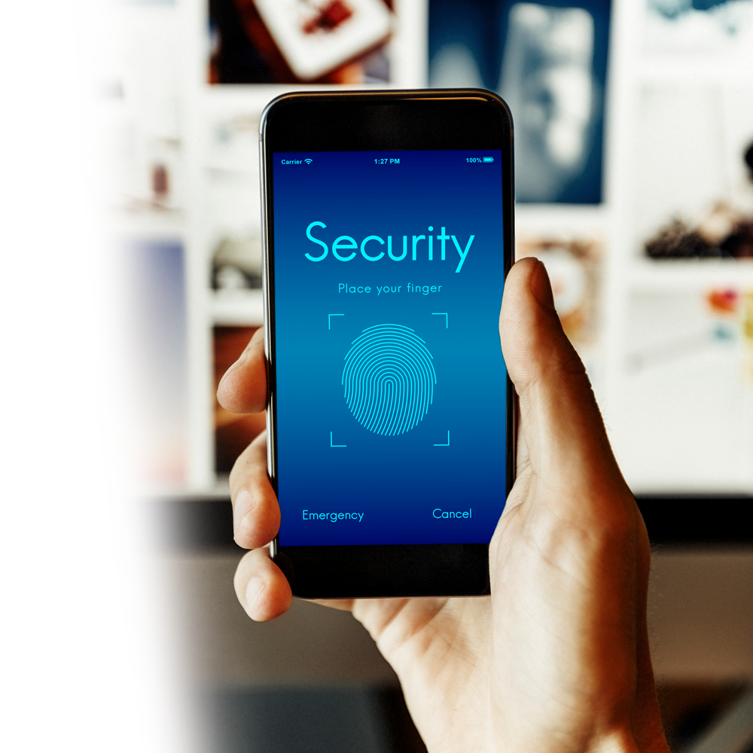
And That is Why…
… You should enable Multi-Factor Authentication
This will help to protect
your account if your
password was stolen or
leaked in a data breach.

Slide 20
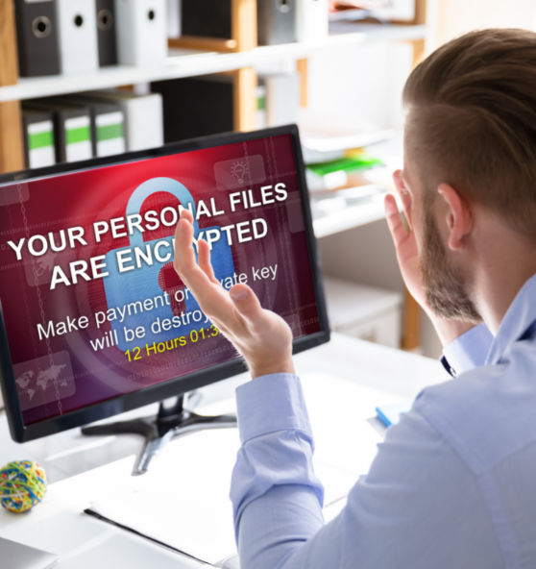
Ransomware
When criminals hack your computer or network, lock you out, and demand a ransom to let you back in.

Slide 21
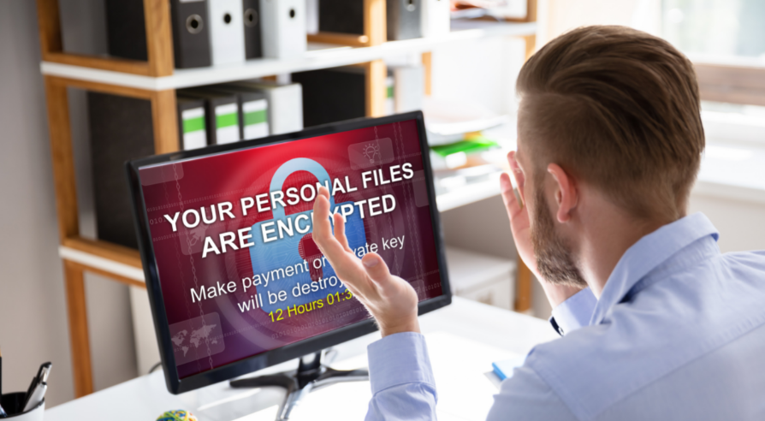
How to Avoid Ransomware
Don’t download files from random websites
Beware of phishing emails with attachments
(See phishing section)
Don’t use your company email or password for personal stuff
Don’t store password in text files or spreadsheets

Slide 22
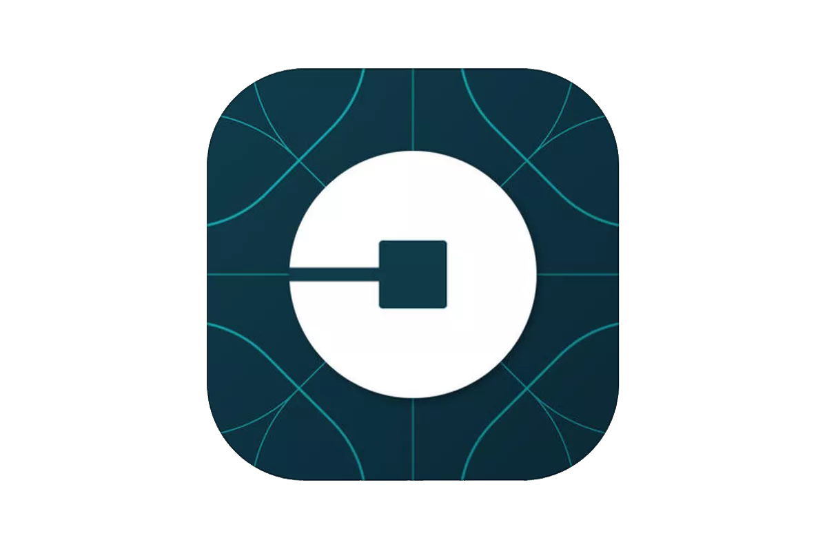
Top 2 Recent Breaches
UBER
GTA 6

Slide 23
Whew!
You made it.

